Slide 1


Coral Gardeners Final Presentation
CSE 237D| Marlyn Arque Rupa, Aleksa Popovic, Ewan Shen, Vibusha Vadivel, Kaleigh Edusada

Slide 2
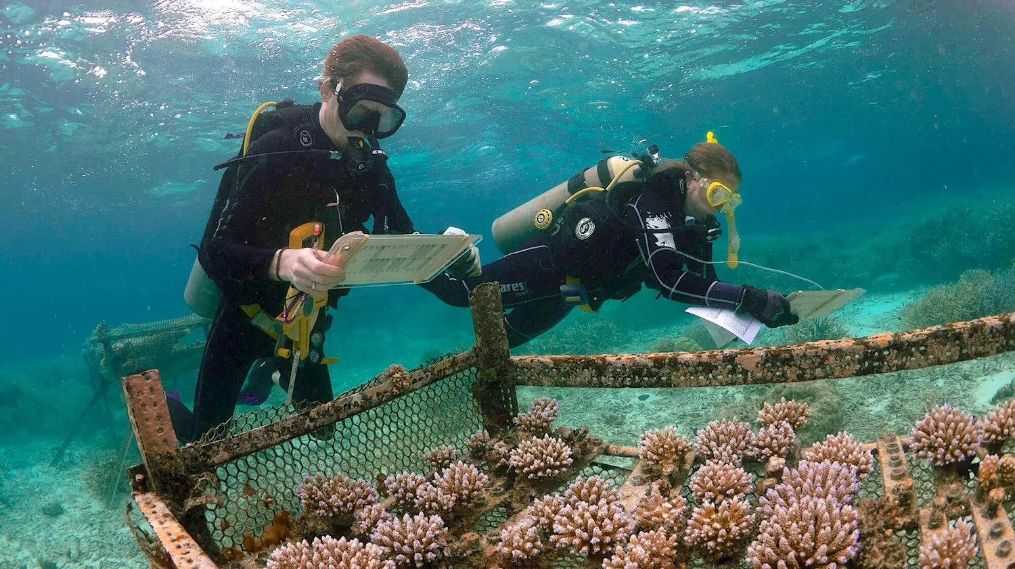
Project Overview
Motivation: Fish biodiversity is an indicator of coral health
Problem: Expert manual analysis of research images is costly, slow
Solution: Detection and classification of fish species with computer vision to expedite and scale image analysis
Key Problems:
Domain Shift
Lack of properly labeled datasets
Notes:
F1 and recall
FOR OVERVIEW MENTION WHAT SAM3 IS AND WHAT RF_DETR IS: RF_DETR - transformer-based segmentation model that does great at domain adaptation
SAM3 - Metas AI foundation model designed for detecting, segmenting, and tracking objects in images
BioCLIP is a biology-focused image classification model

Slide 3
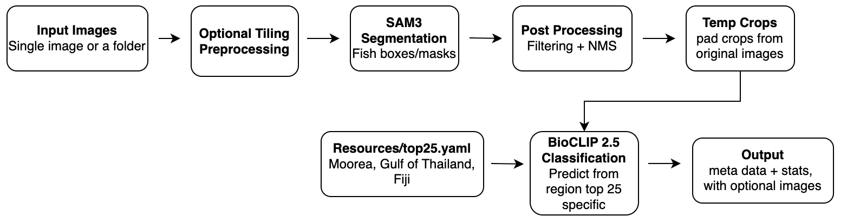
Project Approach
Pipeline:
Deliverables:
Python package
Evaluation results and documentation
Notes:
post processing - sam3 added 25% buffer to the masks and created a bounding box that is then put into the bioclip as a temp image that is later deleted
OBIS data by frequency

Slide 4
Project Development
Project Experimentation:
Custom-trained YOLO v8, v11 and v12 models (<10% accuracy)
Domain Shift
Limited labeled data - hindering training
RF-DETR (~50% accuracy)
Weak generalization
Inconsistent detection with buoys
SAM3 - Hugging Face transformers wrapped
What We Did Do:
Used SAM3 Native for fish localization and BioCLIP for region-aware species classification (79.8% accuracy)
Notes:
For this part of the project, we tested several approaches for fish detection and classification. We started with custom-trained YOLOv8, YOLOv11, and YOLOv12 models, but the accuracy stayed under 10% because of domain shift and limited labeled data. The models had trouble generalizing to the Coral Gardeners underwater footage.
We then tested RF-DETR, which improved to around 50% accuracy, but it still had issues with weak generalization. One major problem was that it sometimes detected buoys as fish, likely because the lighting and shape cues looked similar underwater. To address this, we started creating a negative buoy dataset.
Because of these limitations, we moved to SAM3 Native for fish localization and BioCLIP for region-aware species classification. This worked better because SAM3 located the fish, and BioCLIP matched the cropped image to region-specific species labels. With this setup, we reached about 79.8% accuracy.

Slide 5

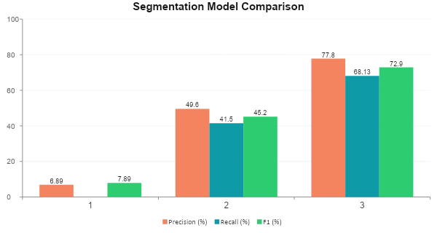
Project Progression - Segmentation
YOLO v8/v11/v12
RF-DETR
SAM3
Custom-trained
Baseline transformer detector
6.9%
49.6%
77.8%
Precision
Precision
Precision
Precision: 6.9% | F1: 7.9%
Domain shift: failed on real footage
Limited labeled data (~7K boxes)
Pivoted away after v8, v11, v12 tests
F1: 45.2% | Recall: 41.5%
3,009 false positives on CG dataset
Buoys detected as fish
Hard-negative dataset built to fix
F1 score: 72.9% | Recall: 68.13%
Best generalization across datasets
Notes:
For this part of the project, we tested several approaches for fish detection and segmentation. We started with custom-trained YOLOv8, YOLOv11, and YOLOv12 models, but the accuracy stayed under 10% because of domain shift and limited labeled data. The models had trouble generalizing to the Coral Gardeners underwater footage.
We then tested RF-DETR, which improved to around 50% accuracy, but it still had weak generalization. One major issue was that it sometimes detected buoys as fish, likely because the lighting and shape cues looked similar underwater. To address this, we started creating a negative buoy dataset.
We initially tested the Hugging Face Transformers SAM3 wrapper for easier Windows integration, but it produced weaker masks in our experiments. We then switched to the native Meta SAM3 implementation with Triton support, which gave better segmentation quality. Overall, SAM3 gave us the strongest localization results and became the segmentation model we moved forward with.

Slide 6
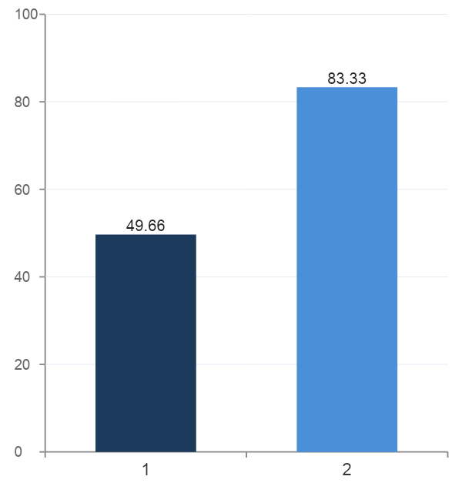
Project Progression - Classification
BioCLIP Classification Accuracy
BioCLIP 2
BioCLIP 2.5
Baseline transformer detector
49.66%
83.33%
Accuracy
Accuracy
No region filtering: classifies from broad species pool
Generic "fish" class scored 0% F1, masking stronger per-species results
Region-constrained to top-25 species per location (Moorea, Fiji, Thailand)
Coral Gardeners Dataset
Notes:
This slide shows the improvement from BioCLIP 2 to BioCLIP 2.5. BioCLIP 2 reached about 49.7% accuracy.
With BioCLIP 2.5, accuracy improved to 83.3%. This improvement happened because it was trained on a bigger data set and improving the sam3 masks, while also creating a top25 species yaml so it reduced the number of species that bioclip can choose from. This is a heavier model and requires more resources, but the accuracy was significantly better.
Overall, the main takeaway is that BioCLIP 2.5 performed much better once we limited the classification choices to species that are more likely to appear in each region.

Slide 7
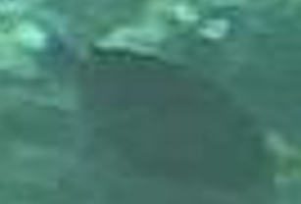

Project Development
What We Did Not Do:
GUI User Interface
Pivot
Detection of Non-Native or Invasive Species
Pivot
Underwater Image Quality through RGB preprocessing
Fish Camouflage
Notes:
We did not build a full GUI user interface, since our main focus was improving the detection and classification pipeline accuracy and this was a stretch goal. So at the moment it is just completely done in the terminal.
We also did not fully complete detection of non-native or invasive species. Our project is completely based on native species from the regions.
With these two, we did not get to it as Mr.Williams suggested that it should not have been our main focus.
Another challenge we did not completely solve was the domain gap between public datasets and real reef images. Public datasets are usually cleaner, while the Coral Gardeners footage has blur, lighting changes, camouflage, and lower image quality.
We also did not fully complete detection of non-native or invasive species. That would require stronger species-level classification and more region-specific validation. So at the moment, our project is completely based on native species from the regions.

Slide 8
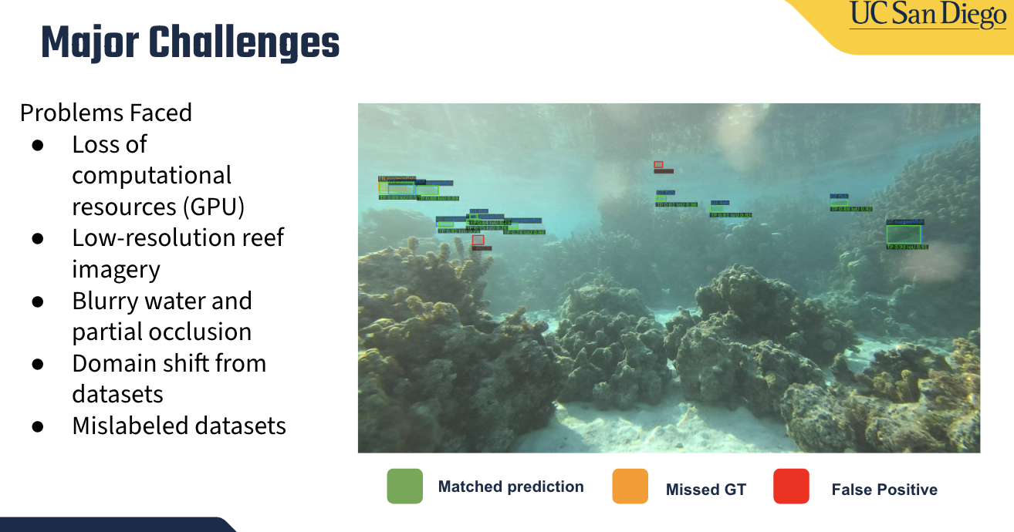
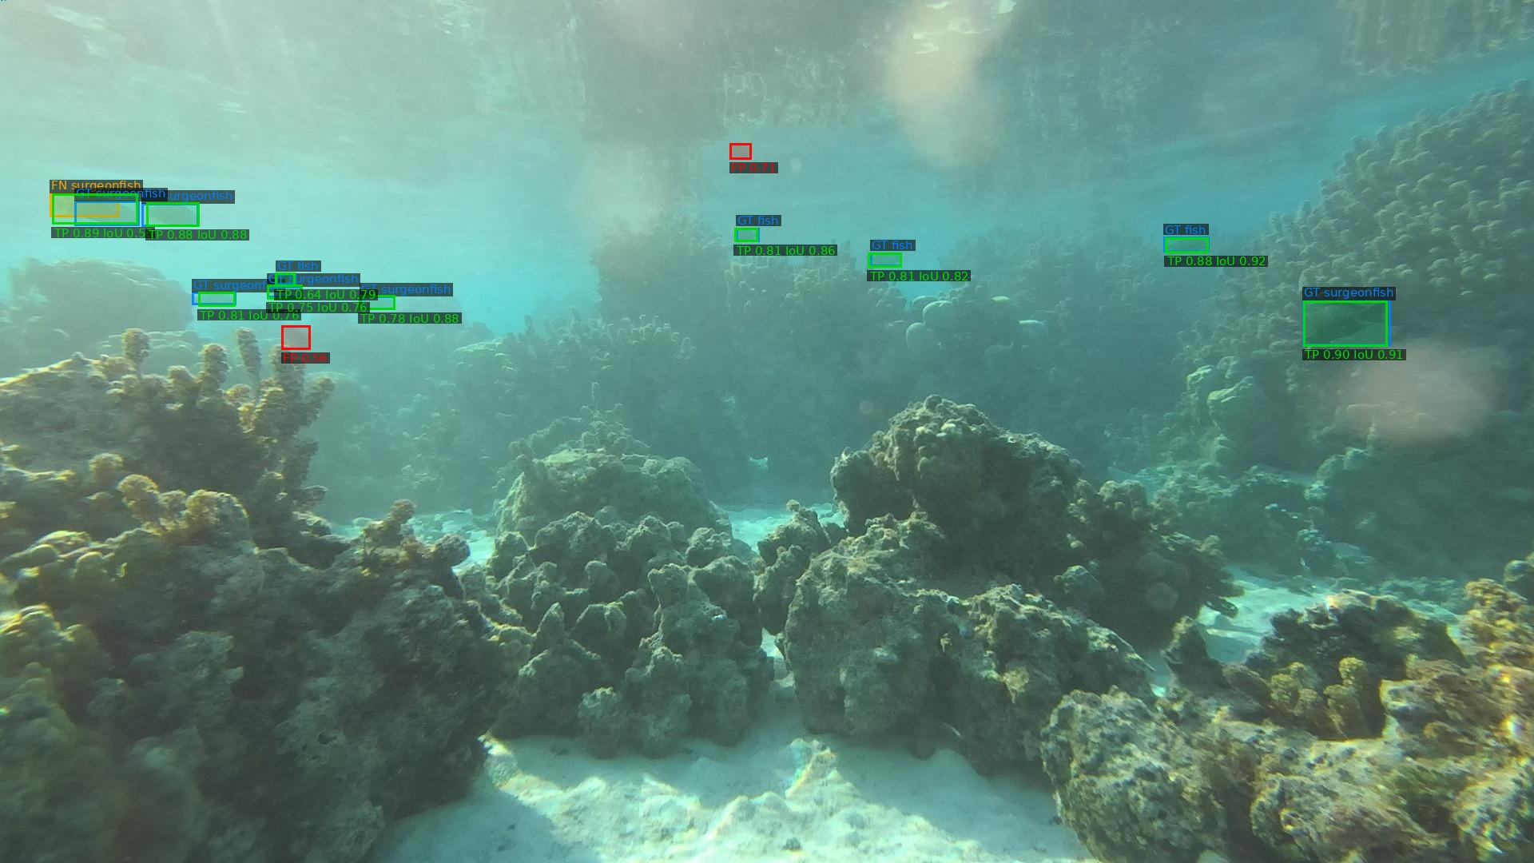
Major Challenges
Problems Faced
Loss of computational resources (GPU)
Low-resolution reef imagery
Blurry water and partial occlusion
Domain shift from datasets
Mislabeled datasets
Matched prediction
Missed GT
False Positive
Notes:
One issue was losing access to GPU resources, which slowed down training and testing. Another major challenge was the quality of the reef imagery. Many images were low-resolution, blurry, or had fish partially blocked by coral or water movement. As you can see in the image, it is very blurry and far away, but we are still able to detect and have a good accuracy.
The example on the right shows how difficult detection can be in this environment. Green boxes are matched predictions, orange boxes are missed ground truth, and red boxes are false positives. This shows that the model can detect some fish correctly, but it can also miss fish or mistake background objects for fish.
Overall, the biggest challenge was the domain shift between cleaner public datasets and real underwater reef footage. The reef images are much harder because of lighting, camouflage, blur, and inconsistent labels.

Slide 9
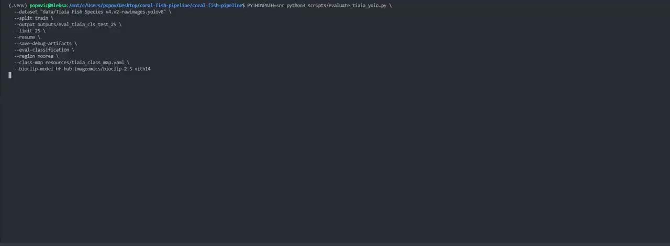
Project Demonstration

Slide 10
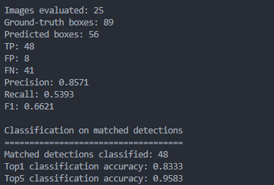
Project Demonstration

Slide 11
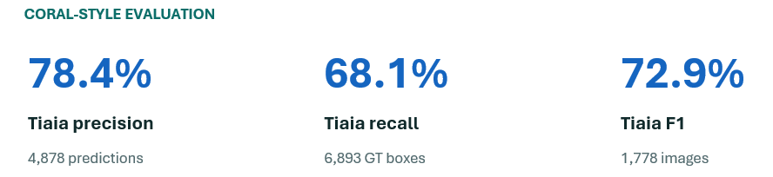
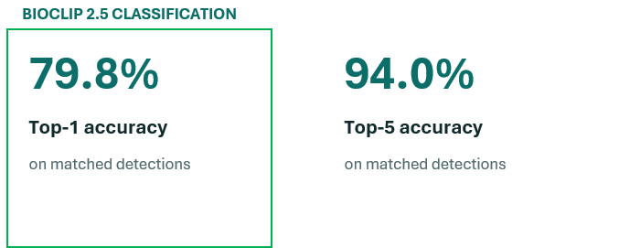
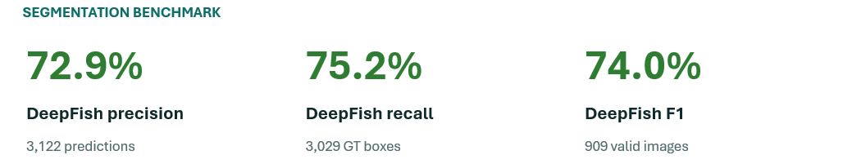
Project Demonstration

Slide 12
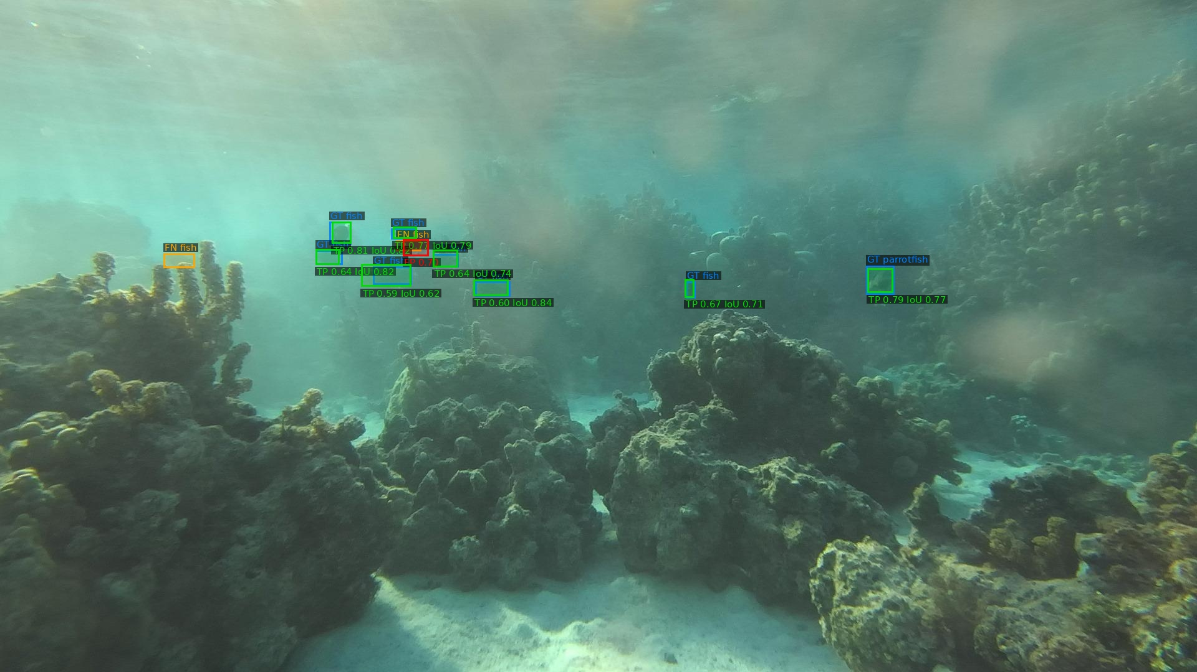
Project Demonstration
Matched prediction
Missed GT
False Positive

Slide 13

Conclusion
Project Summary:
Built end-to-end pipeline
Identified major failure points
Improved performance through model choice
Key Problems:
Domain shift and low resolution data
Future Work:
Develop lightweight UI for image upload and species prediction display
Explore real-time deployment for reef biodiversity monitoring
Experiment with newly released LocateAnything
Notes:
reducing domain-shift problems so the package works reliably on real Coral Gardeners imagery.

